Slide 1
AI桌球即時自動計分系統之研究
Speaker : Chao-En Huang、Jiunn-Lin Wu
Date : May 23, 2025

Slide 2
Outline
Introduction
Proposed Method
Object Detection Model
Trajectory Management Mechanism
Bounce Detection Method
Experimental Results
Conclusion and Future Work

Slide 3
Introduction

Slide 4
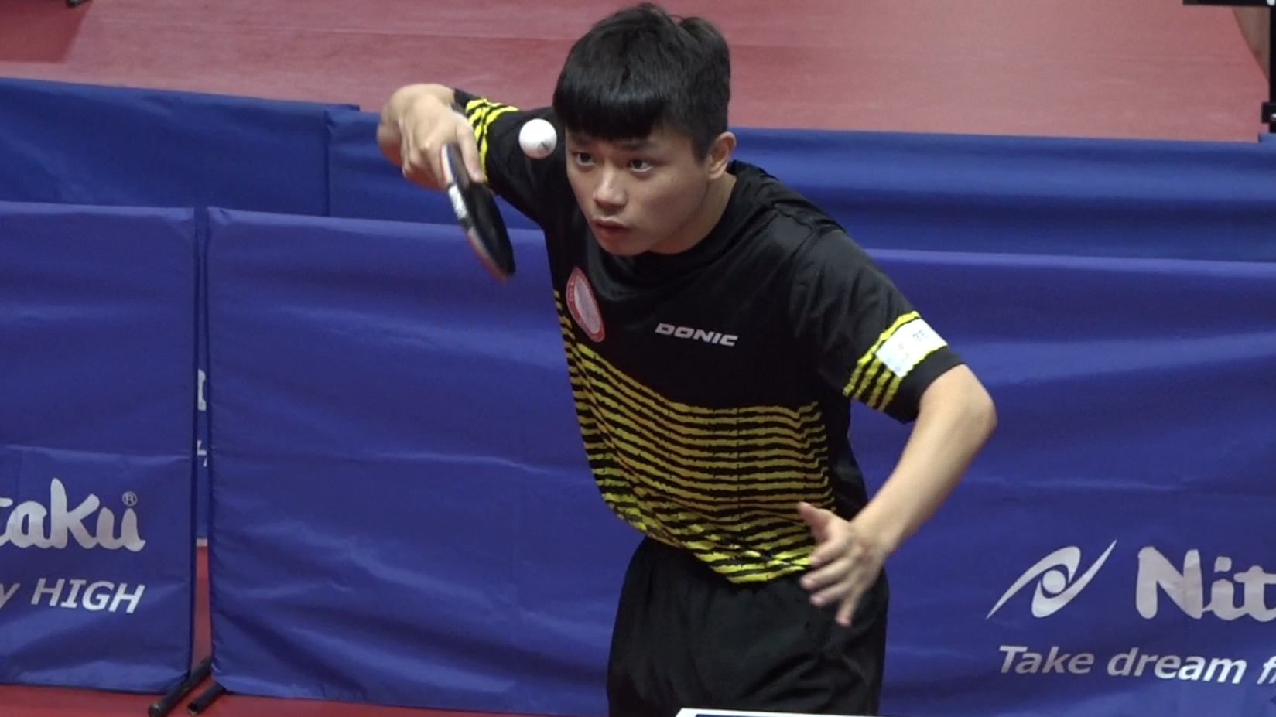
The Role of Computer Vision and AI in Sports Analysis
With the advancement of computer vision and AI technologies, image recognition and object tracking have been widely applied, particularly in sports analysis.
These techniques not only enhance athlete performance but also support strategy development, training evaluation, and post-match analysis.
In fast-motion sports such as table tennis, they enable precise tracking of high-speed objects and facilitate accurate analysis of trajectories and bounce points, making them essential for real-time scoring systems.
Taiwan table tennis national player Wang Wei Peng.

Slide 5
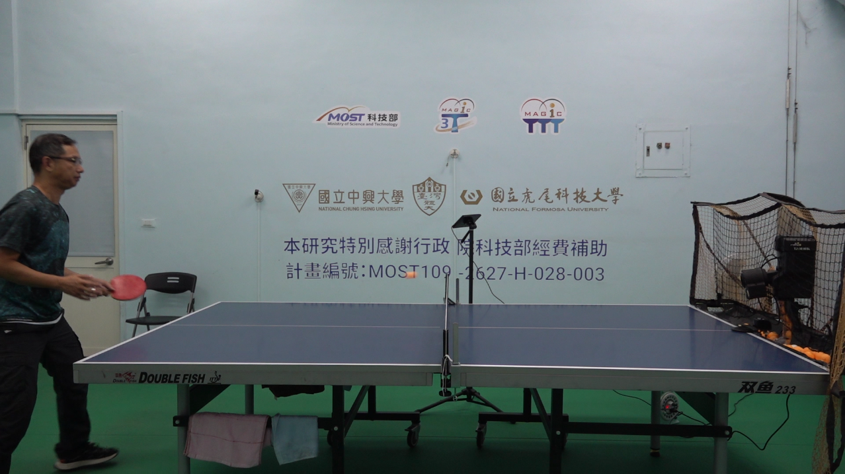
Ball-Serving Machines in Table Tennis Training
In table tennis training, ball-serving machines provide athletes with a stable and adjustable environment, enabling repetitive and systematic practice.
These machines can generate consistent trajectories with adjustable speed, spin, and angle, allowing players to refine their techniques efficiently.
By automating ball delivery, they help athletes focus on skill improvement and adapt to various shot patterns, which is essential for enhancing competitive performance.
Interaction Between Ball-Serving Machines and Athlete Training.

Slide 6
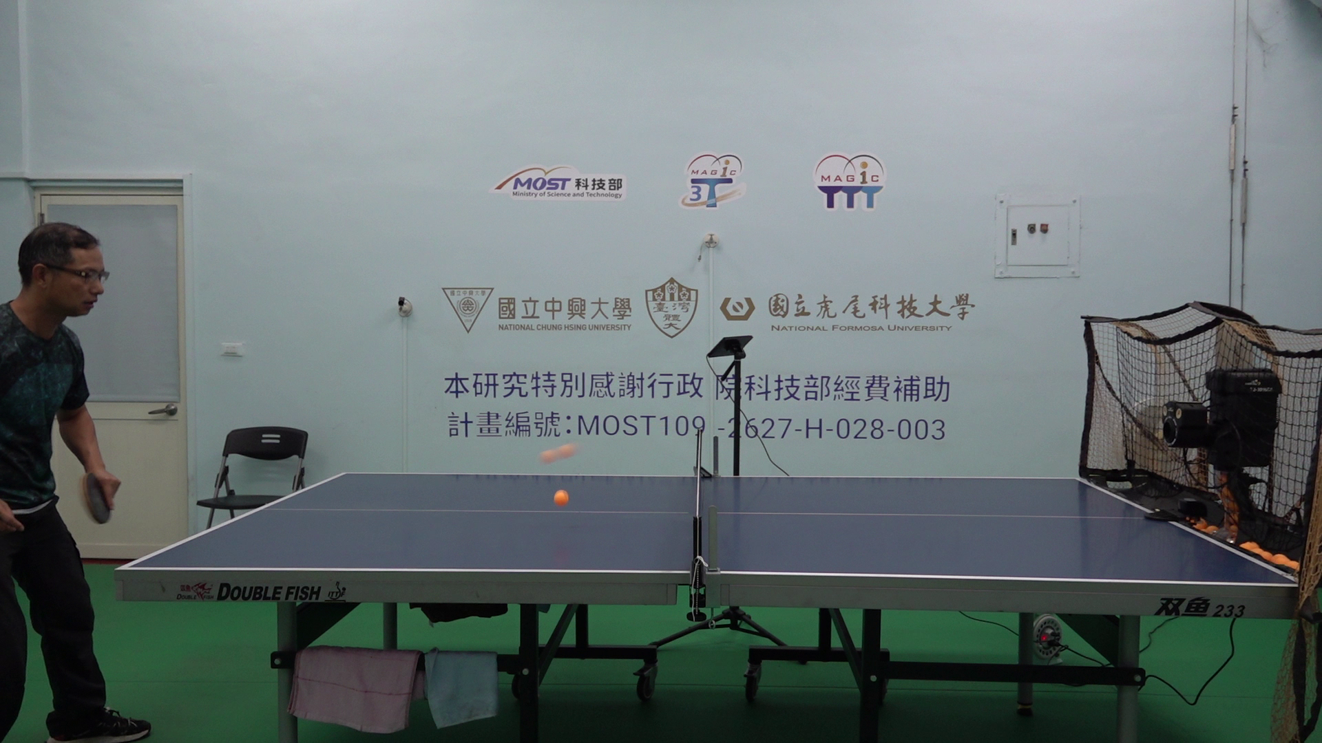

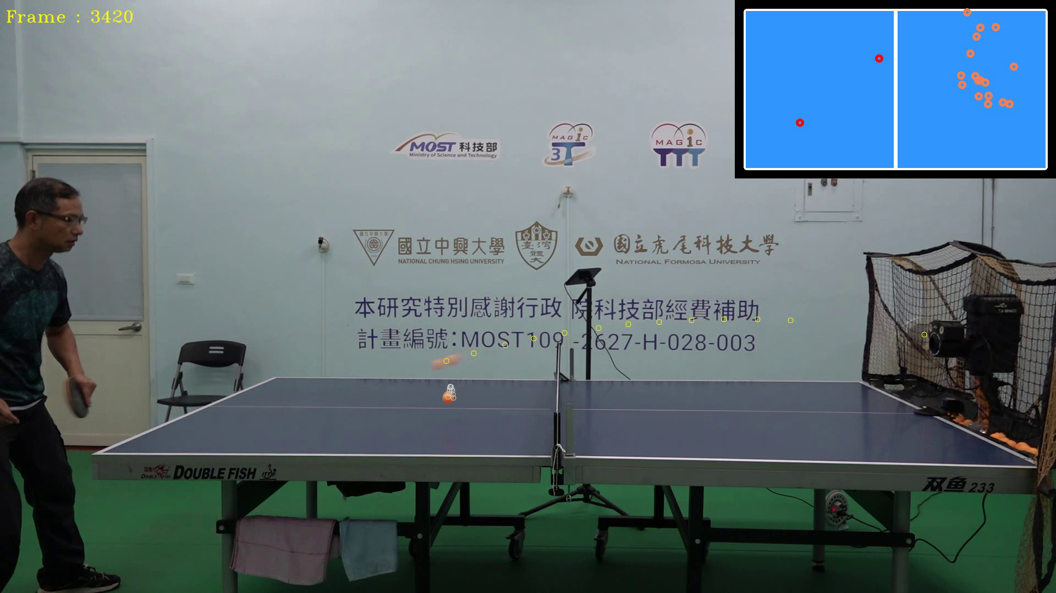
Challenges in Multi-Ball Tracking
Table tennis, characterized by fast-paced and dynamic movements, poses significant challenges for image recognition and object tracking systems.
The rapid motion of the ball, complex backgrounds, and the presence of multiple balls during training sessions make it difficult for conventional algorithms to maintain both accuracy and real-time processing.
Precisely tracking small balls and distinguishing between multiple trajectories remain major technical obstacles.
Original frame.
Small ball detection.
Trajectory assignment.

Slide 7
Proposed Method

Slide 8
Motivation of This Study
Accurately tracking fast-moving table tennis balls poses significant challenges, especially in dynamic environments with multiple balls.
Traditional methods often fail to maintain both accuracy and real-time performance, particularly in detecting bounce points and calculating landing coordinates.
To address this, we propose a YOLOv7-based approach that combines high-speed object detection with a robust trajectory management mechanism for multi-ball tracking.
Our method also incorporates bounce detection to ensure each trajectory accurately captures the correct landing point, enhancing both accuracy and real-time performance.

Slide 9
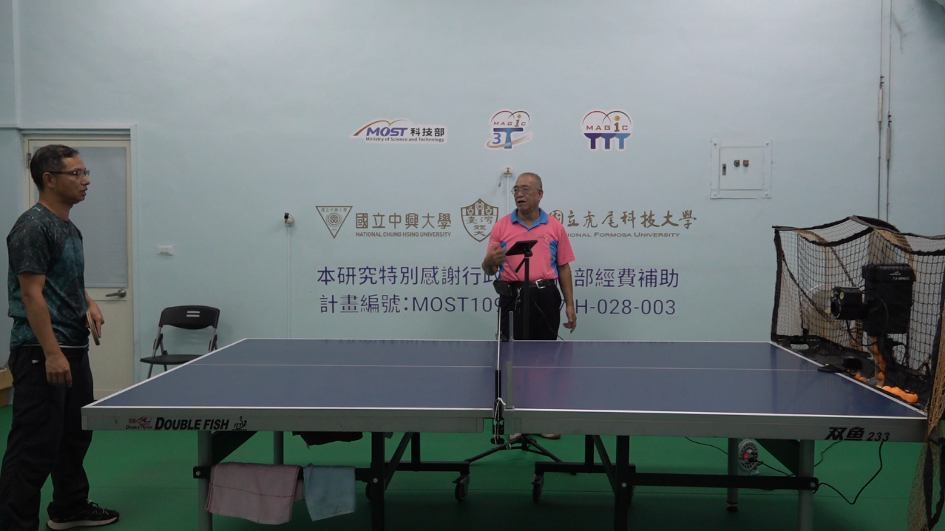
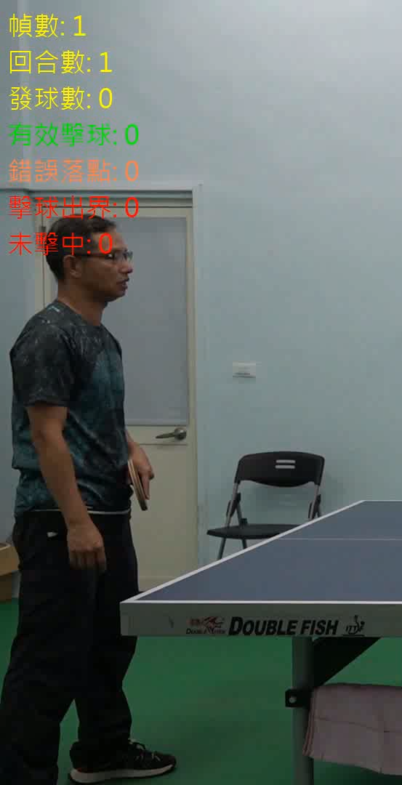
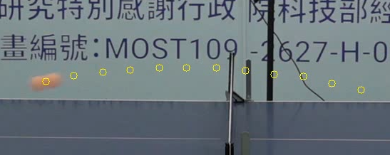
Flowchart of Proposed Method
First, the proposed method uses YOLOv7 to detect and track fast-moving table tennis balls.
Second, it updates the ball trajectory by analyzing motion characteristics between consecutive frames.
Third, it identifies bounce frames by detecting deviations from the parabolic motion model.
Finally, it applies perspective transformation to map the landing point on the table and classify the region.
Ball Position Extraction
Ball Trajectory
Trajectory Analysis
Using YOLOv7
Valid Hits
Input
Video
Output
Video
Side Errors
Misses
Out of Bounds

Slide 10
Flowchart of Proposed Method
In the next part, we are going to introduce the stage of object detection.
Ball Position Extraction
Ball Trajectory
Trajectory Analysis
Using YOLOv7
Valid Hits
Input
Video
Output
Video
Side Errors
Misses
Out of Bounds

Slide 11
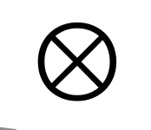
Object Detection Model (1/2)
In recent years, deep learning techniques have been widely applied in image classification, object detection, and semantic segmentation.
The core architecture for these tasks is the Convolutional Neural Network (CNN), which combines feature extraction and classification.
Convolutional layers use learnable kernels to capture high-level semantic features, while pooling layers reduce spatial dimensions.The extracted features, represented as feature maps, are fed into the classification network for decision-making.
2 | 0 | 2 | 4 | 0
0 | 7 | 0 | 1 | 7
2 | 0 | 2 | 3 | 2
1 | 9 | 9 | 9 | 5
1 | 1 | 0 | 9 | 6
0 | 1 | 0
1 | 0 | 1
0 | 1 | 0
0
Convolutional Network Operations.

Slide 12
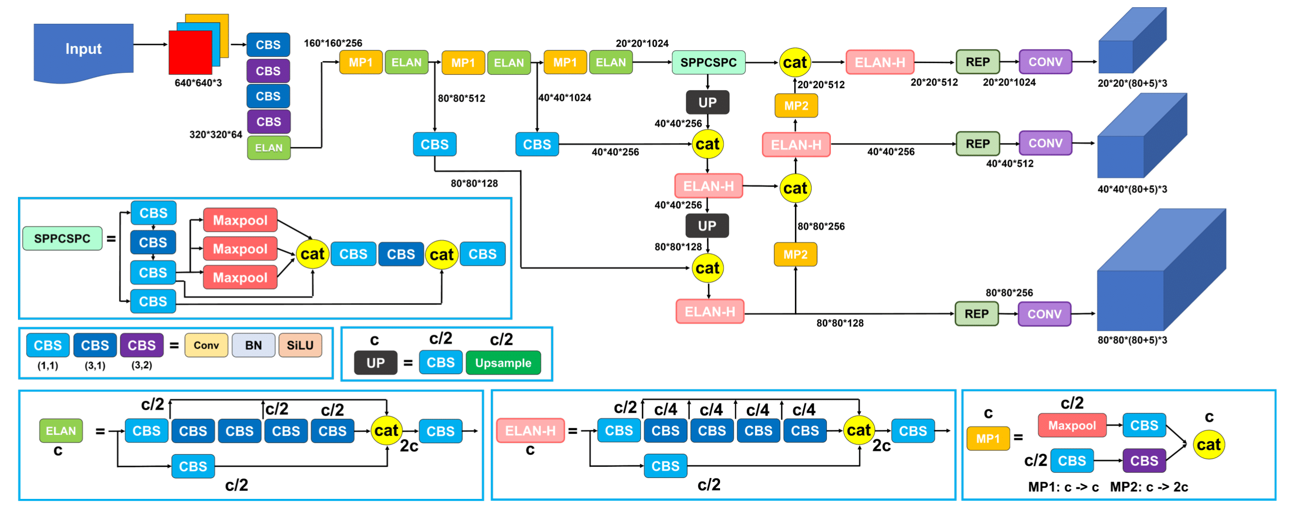
Object Detection Model (2/2)
Convolutional Neural Networks (CNNs) are widely used for object detection tasks, particularly for localization and classification.
One-stage detection models like SSD, RetinaNet, and YOLO are known for their efficiency and real-time performance.
YOLOv7, in particular, balances speed and accuracy, making it highly suitable for tracking fast-moving table tennis balls in dynamic settings.
Architecture of YOLOv7.

Slide 13
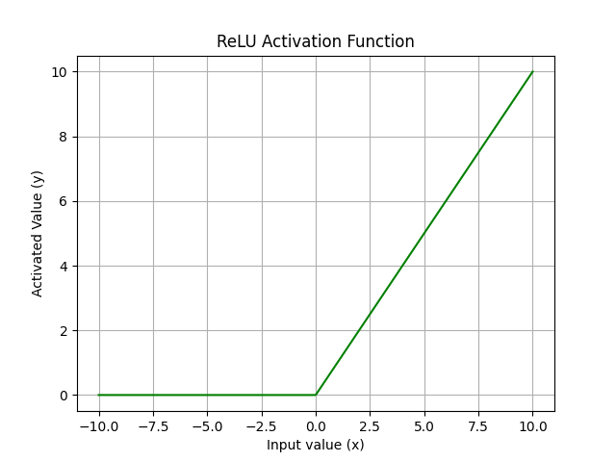
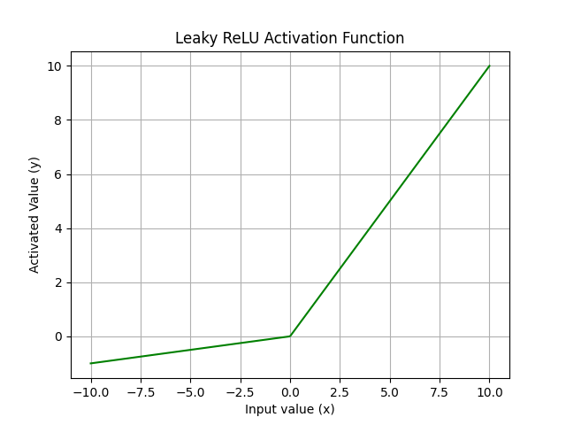
Activation Function
In image feature extraction, linear mapping limits the network's ability to capture complex patterns.
Activation functions introduce nonlinearity to enable more expressive mappings.
ReLU and Leaky ReLU are commonly used, with Leaky ReLU addressing the dead neuron problem by maintaining non-zero gradients in the negative region.
ReLU operation.
Leaky ReLU operation.

Slide 14
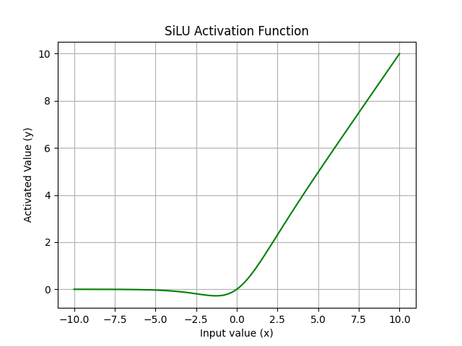
Sigmoid Linear Unit (SiLU)
YOLOv7 uses the Sigmoid Linear Unit (SiLU) activation function to enhance learning capability.
SiLU combines the input with its Sigmoid value, resulting in a smooth output that transitions linearly for large inputs and approaches zero for small inputs.
This smoothness stabilizes gradient updates, improves convergence, and enhances the model's ability to learn complex features.
SiLU operation.

Slide 15

Bounding Box Loss Function
In deep convolutional neural network training, the model minimizes the loss function to reduce prediction errors and improve accuracy.
In object detection tasks, Intersection over Union (IoU) measures the overlap between predicted and ground truth bounding boxes, calculated as the intersection area divided by the union area.
However, IoU mainly evaluates the overlap ratio and may neglect internal gaps or background regions within the bounding box, leading to inaccurate detection assessments when non-object areas are included.
$$IoU=\frac{Area of Intersection}{Area of Union}$$

Slide 16
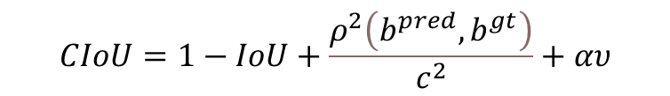
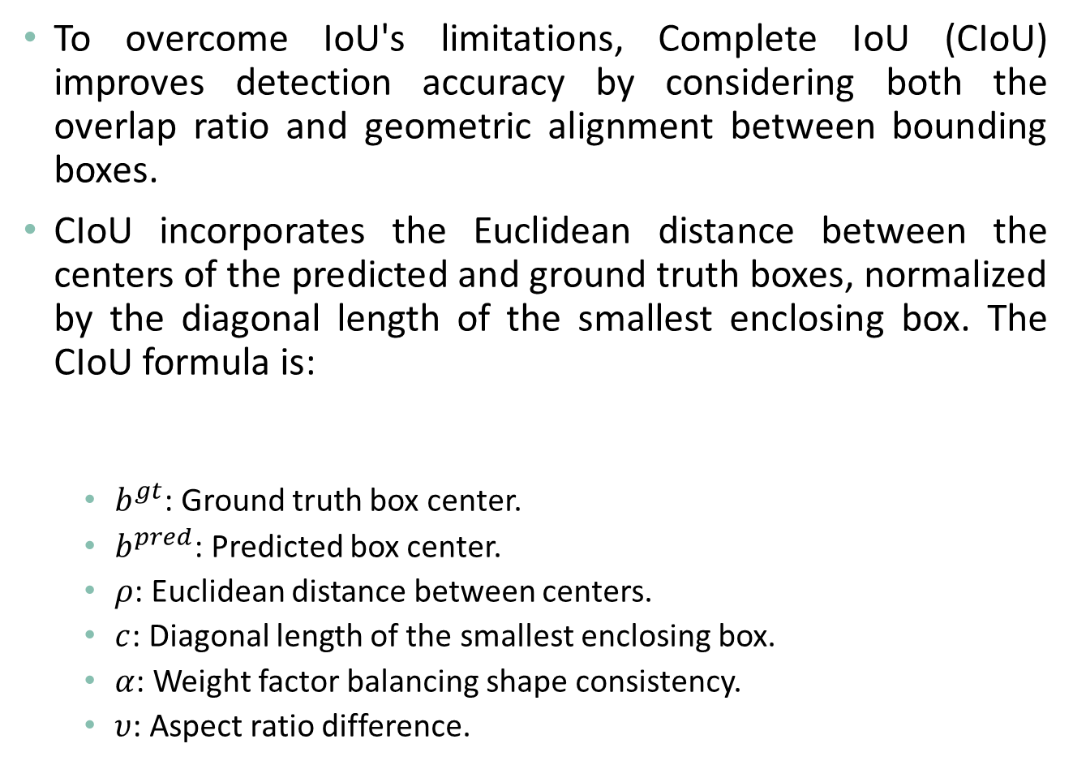
Complete IoU (CIoU)
To overcome IoU's limitations, Complete IoU (CIoU) improves detection accuracy by considering both the overlap ratio and geometric alignment between bounding boxes.
CIoU incorporates the Euclidean distance between the centers of the predicted and ground truth boxes, normalized by the diagonal length of the smallest enclosing box. The CIoU formula is:
$b^{gt}$: Ground truth box center.
$b^{pred}$: Predicted box center.
$ρ$: Euclidean distance between centers.
$c$: Diagonal length of the smallest enclosing box.
$α$: Weight factor balancing shape consistency.
$υ$: Aspect ratio difference.
$$CIoU=1−IoU+\frac{ρ^{2}\left(b^{pred},b^{gt}\right)}{c^{2}}+αυ$$

Slide 17
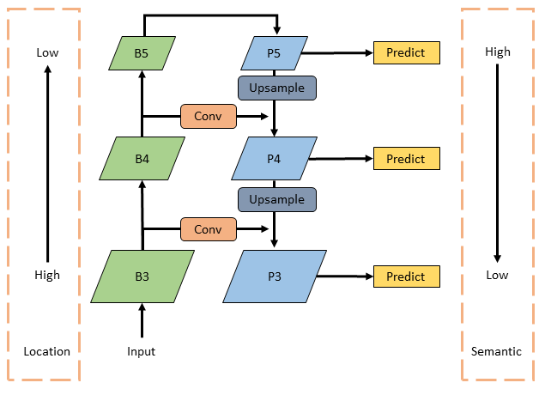
Multi-Scale Feature Fusion Framework
Feature Pyramid Network (FPN) and Path Aggregation Network (PAN) are key components for multi-scale feature extraction in YOLOv7, enhancing object detection across various sizes and shapes.
FPN uses a top-down approach to pass high-level features to lower layers, aiding small object detection.
PAN, in contrast, aggregates spatial details from lower layers with semantic information from higher layers, ensuring accurate and efficient detection.
Multi-Scale Feature Fusion: FPN and PAN.

Slide 18
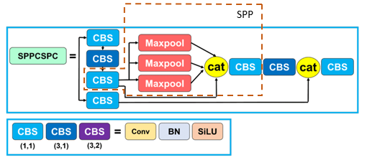
SPPCSPC Network
SPPCSPC combines Spatial Pyramid Pooling (SPP) and Cross Stage Partial Network (CSPNet) to enhance feature extraction and expand the receptive field.
SPP captures multi-scale features using max pooling, while CSPNet splits the feature map to balance feature extraction and computational efficiency.
This fusion improves detection accuracy and speed, especially for objects of varying sizes.
Architecture of SPPCSPC.

Slide 19
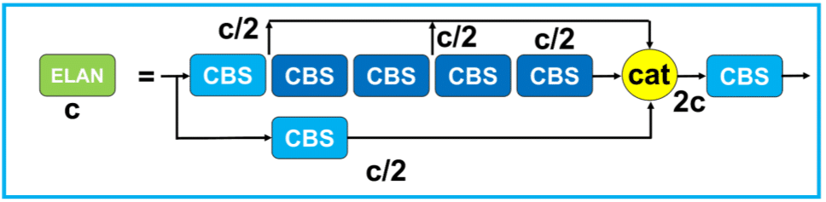
Efficient Layer Aggregation Network
The Efficient Layer Aggregation Network (ELAN) is designed for efficient feature extraction in object detection.
It optimizes gradient flow by balancing short and long paths, addressing convergence issues in deep networks.
ELAN's architecture enhances gradient propagation, allowing deeper models to train effectively without performance degradation.
This design improves detection accuracy and inference speed by efficiently aggregating multi-level features.
Architecture of ELAN.

Slide 20
Flowchart of Proposed Method
In the next part, we are going to introduce the stage of trajectory management mechanism.
Ball Position Extraction
Ball Trajectory
Trajectory Analysis
Using YOLOv7
Valid Hits
Input
Video
Output
Video
Side Errors
Misses
Out of Bounds

Slide 21
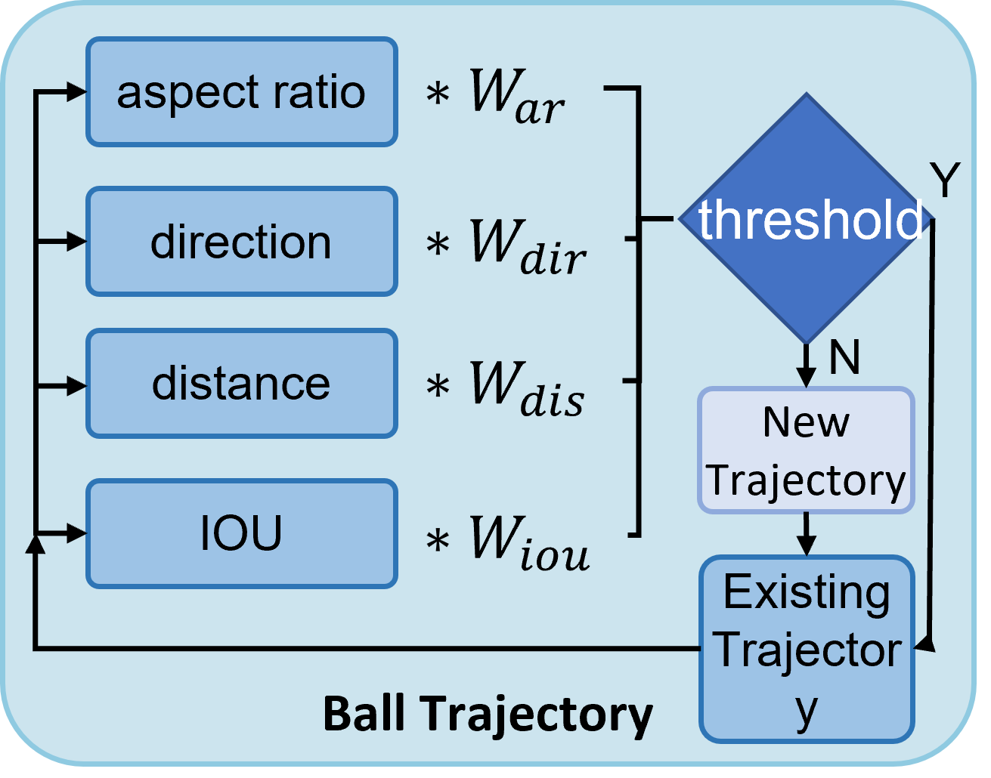
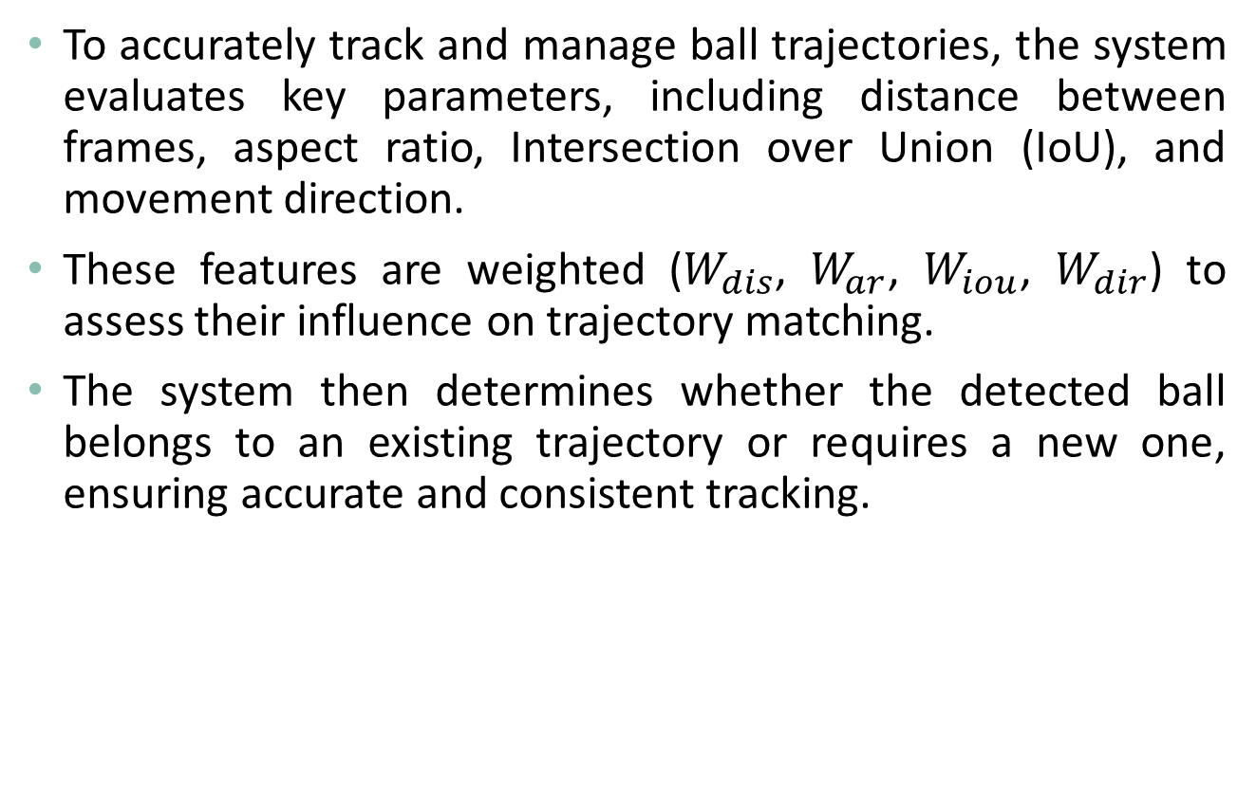
Trajectory Management Mechanism
To accurately track and manage ball trajectories, the system evaluates key parameters, including distance between frames, aspect ratio, Intersection over Union (IoU), and movement direction.
These features are weighted ($W_{dis}$, $W_{ar}$, $W_{iou}$, $W_{dir}$) to assess their influence on trajectory matching.
The system then determines whether the detected ball belongs to an existing trajectory or requires a new one, ensuring accurate and consistent tracking.
Flowchart of the Trajectory Management Mechanism.

Slide 22
Flowchart of Proposed Method
In the next part, we are going to introduce the stage of the bounce detection method, which classifies hit types based on landing points.
Ball Position Extraction
Ball Trajectory
Trajectory Analysis
Using YOLOv7
Valid Hits
Input
Video
Output
Video
Side Errors
Misses
Out of Bounds

Slide 23
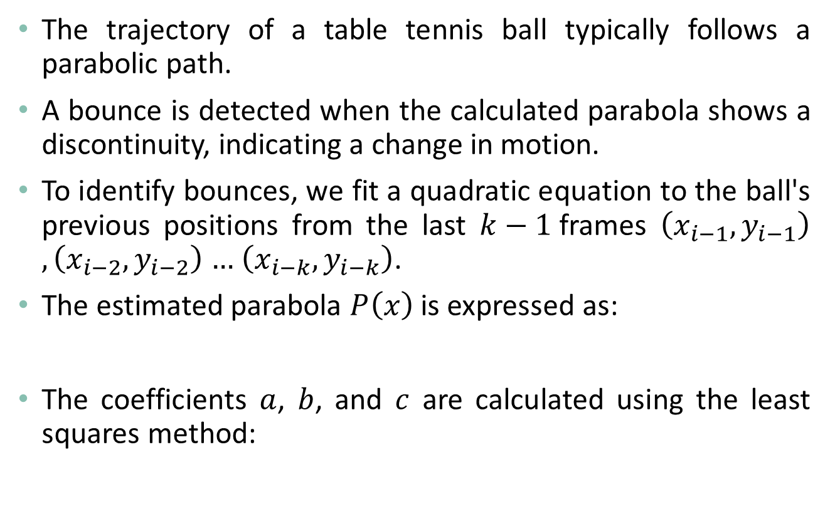

Bounce Detection
The trajectory of a table tennis ball typically follows a parabolic path.
A bounce is detected when the calculated parabola shows a discontinuity, indicating a change in motion.
To identify bounces, we fit a quadratic equation to the ball's previous positions from the last $k−1$frames $\left(x_{i−1},y_{i−1}\right)$ $, \left(x_{i−2},y_{i−2}\right)$ $…$ $\left(x_{i−k},y_{i−k}\right)$.
The estimated parabola $P\left(x\right)$ is expressed as:
The coefficients $a$, $b$, and $c$ are calculated using the least squares method:
$$P(x)=ax^{2}+bx+c, which a,b,c are constants$$
$$X={(A^{T}A)}^{−1}A^{T}B$$

Slide 24
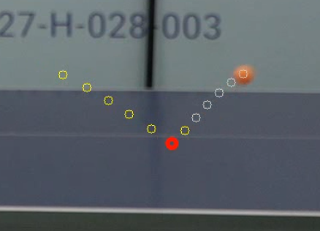
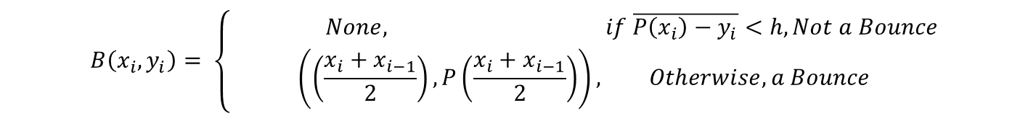
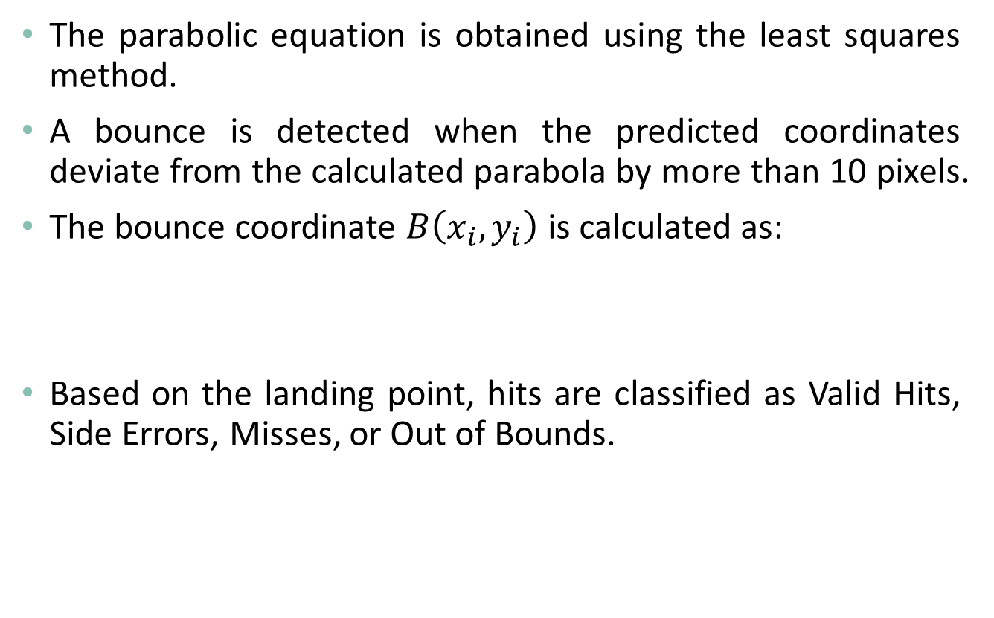
Bounce Coordinate Calculation
The parabolic equation is obtained using the least squares method.
A bounce is detected when the predicted coordinates deviate from the calculated parabola by more than 10 pixels.
The bounce coordinate $B\left(x_{i},y_{i}\right)$ is calculated as:
Based on the landing point, hits are classified as Valid Hits, Side Errors, Misses, or Out of Bounds.
$$B\left(x_{i},y_{i}\right)= \left\{\begin{aligned} None, if \overline{P\left(x_{i}\right)−y_{i}}<h, Not a Bounce \\ \left(\left(\frac{x_{i}+x_{i−1}}{2}\right),P\left(\frac{x_{i}+x_{i−1}}{2}\right)\right), Otherwise, a Bounce\end{aligned}\right.$$
Bounce Coordinate Prediction.

Slide 25
Experimental Results

Slide 26
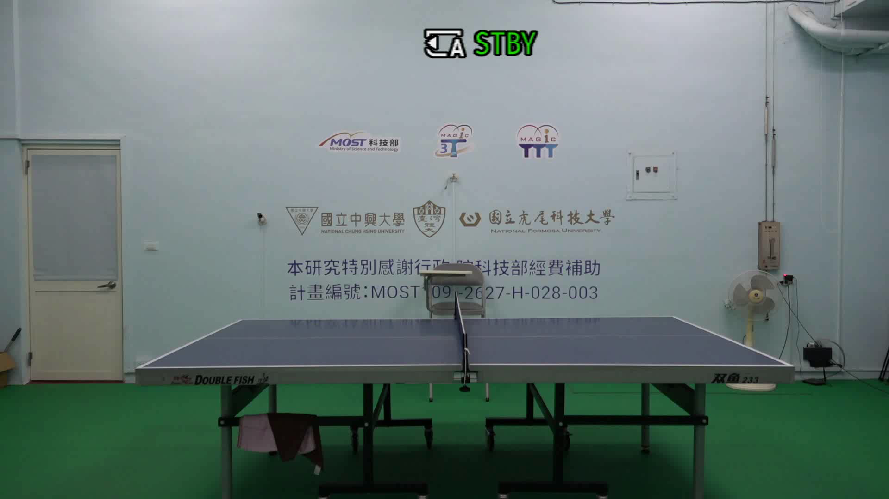
Experimental Environment
Experiments were conducted at the Smart Table Tennis Classroom of National Chung Hsing University, recording ball-serving processes using a ball machine.
These recordings formed an image dataset covering various ball trajectory scenarios.
The dataset was used to evaluate the proposed YOLOv7-based tracking system, demonstrating its adaptability and efficiency in high-speed motion conditions.
The Smart Table Tennis Classroom of National Chung Hsing University.

Slide 27
System Performance Evaluation
To evaluate real-time performance, we processed experimental videos.
The system efficiently tracked ball trajectories and detected landing points in about one-third of the recording time.
In a 1-minute and 31-second video, YOLOv7 achieved 58.1 FPS, enabling real-time detection.
The system accurately calculated changes in aspect ratio, direction, distance, and IoU between frames to track trajectories. When the ball deviated from the parabolic path, the landing point was identified.
The entire process took 39 seconds, demonstrating the system's effectiveness in high-speed scenarios.
 | Video Length | YOLO | Ball Trajectory Tracking | Total Processing Time
Time | 1 min 31 sec | 58.1 FPS | 39 sec | 39 sec

Slide 28
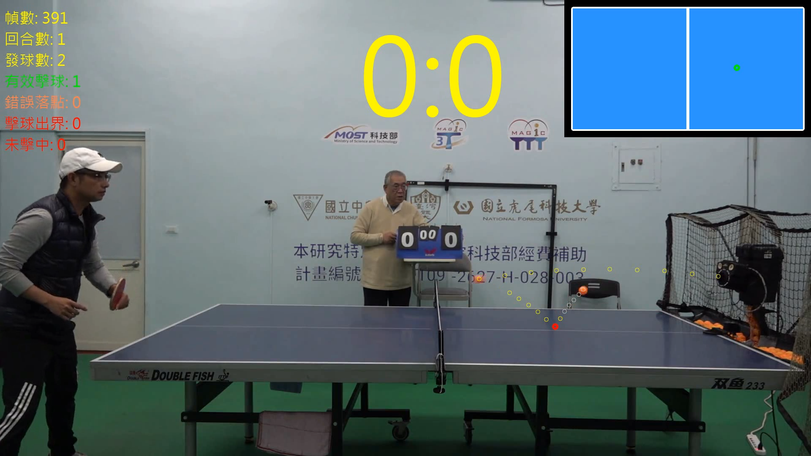
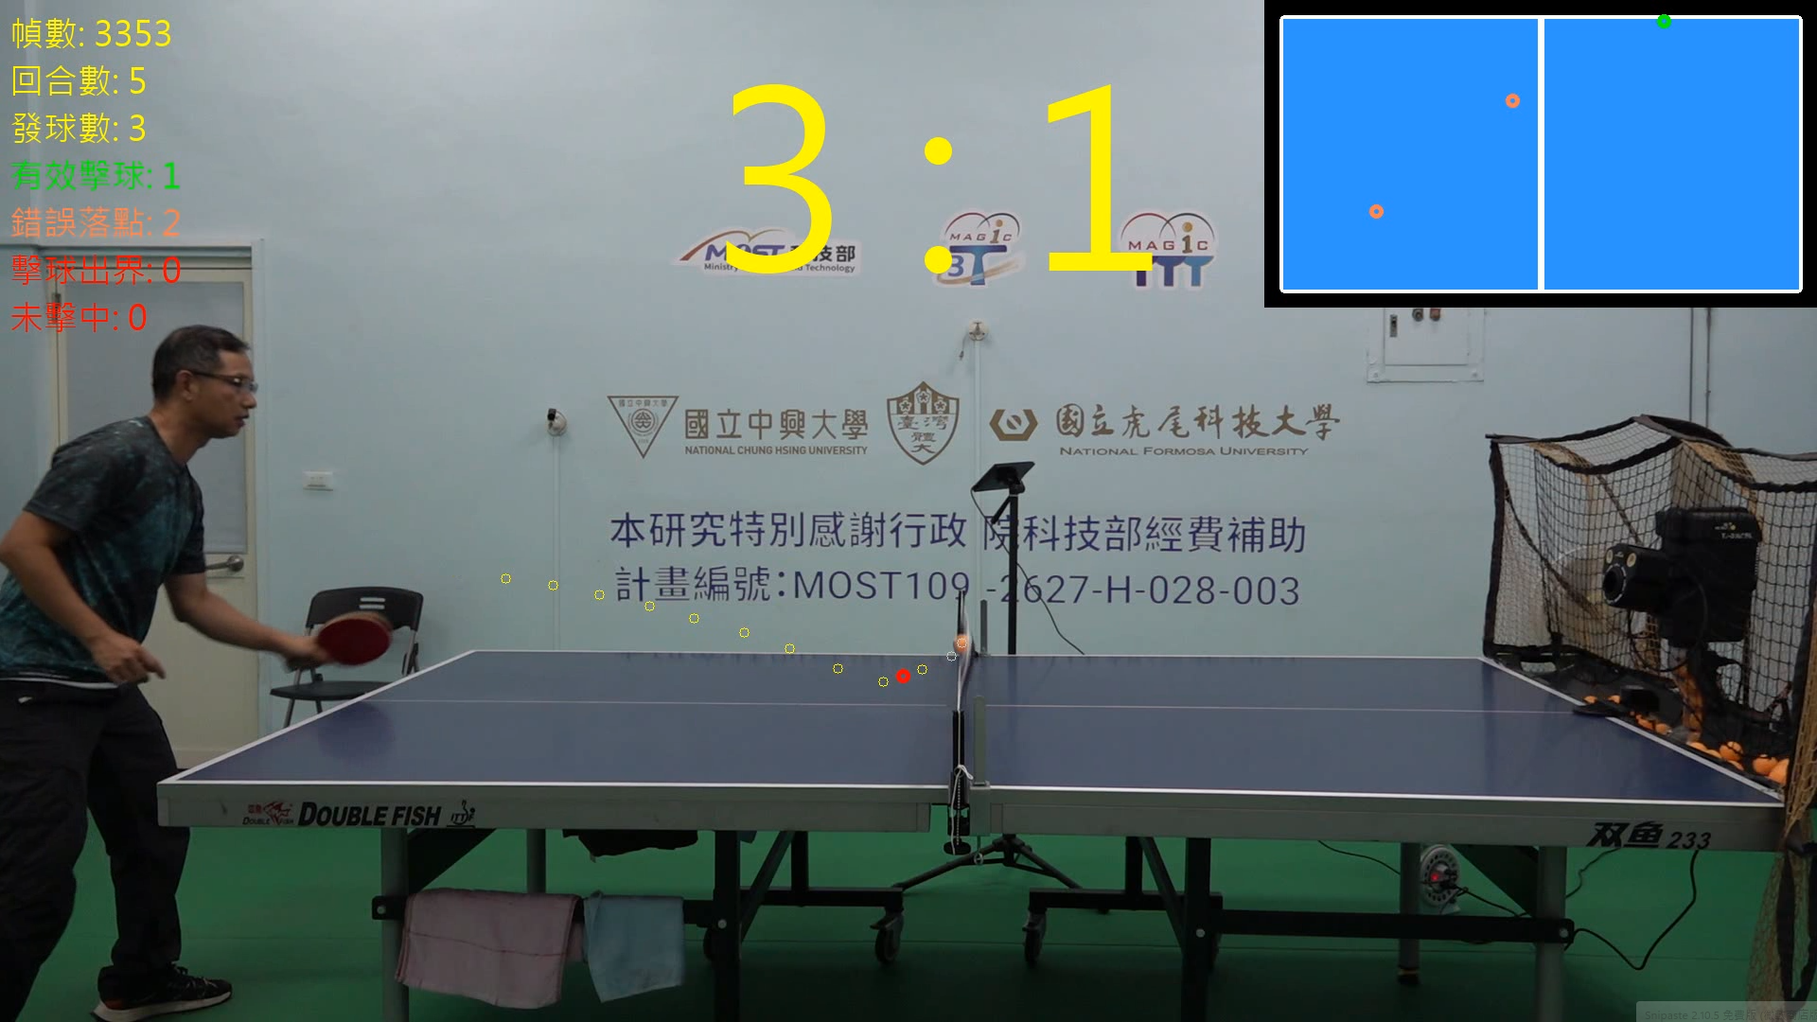
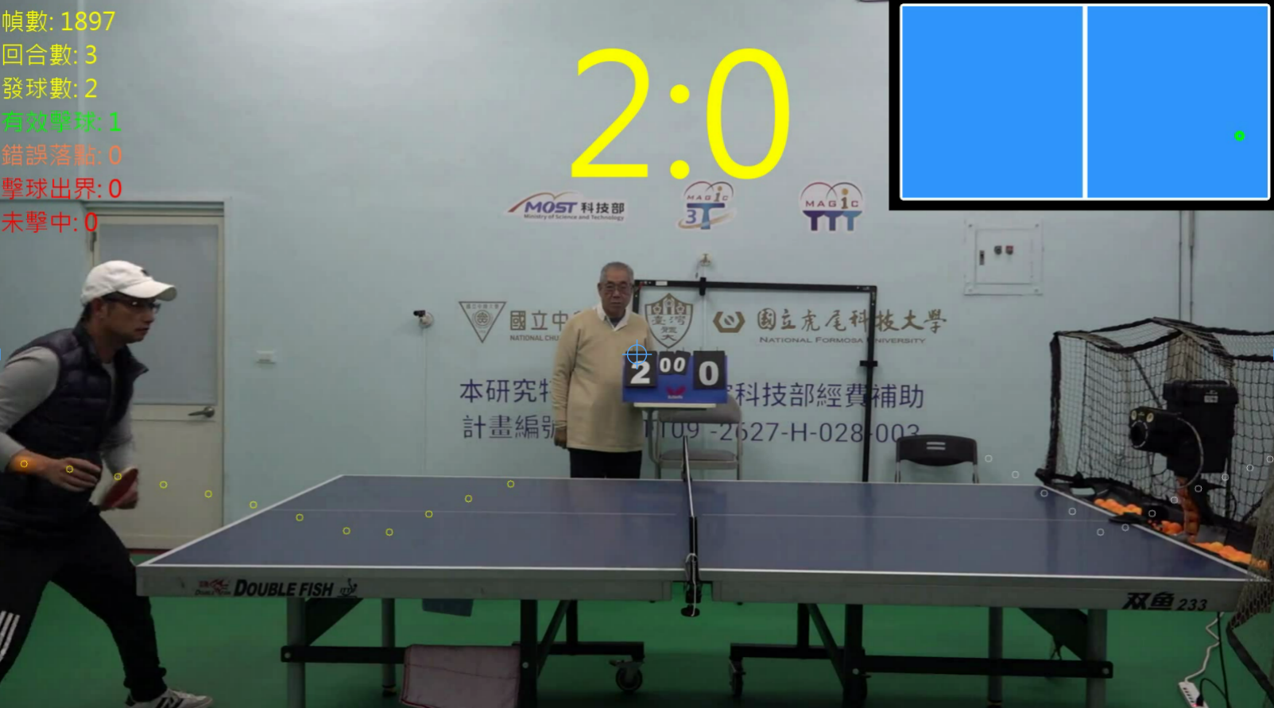
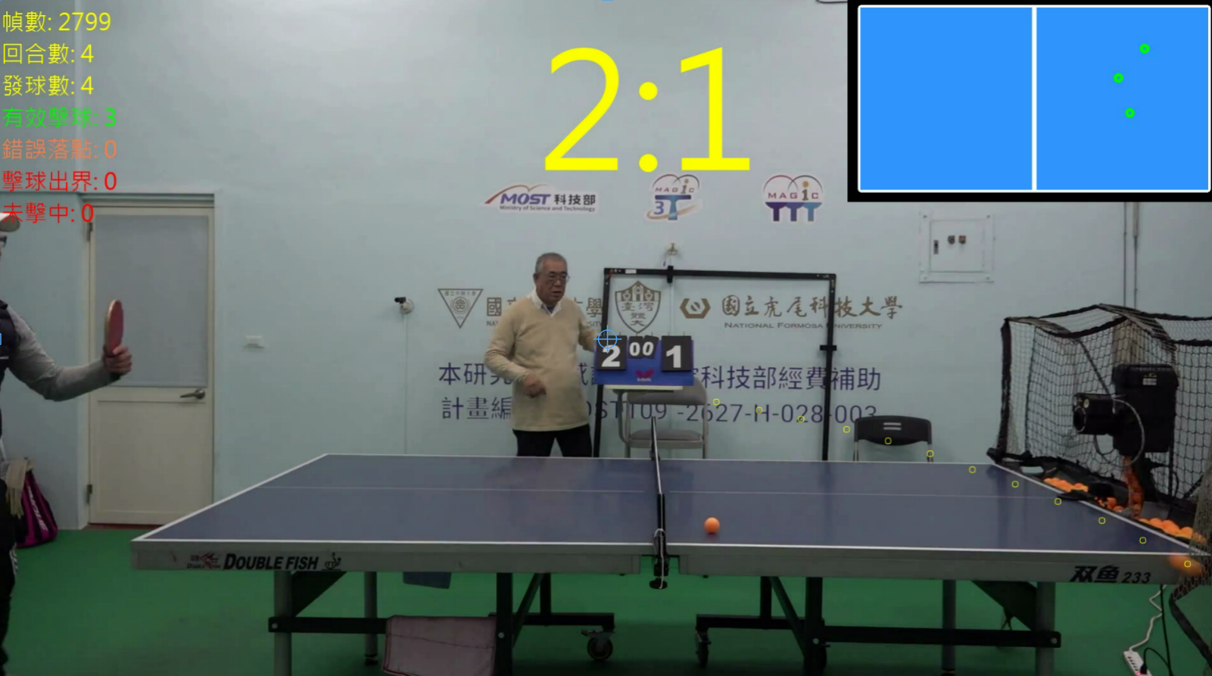
Hit Classification and Scoring
The system uses trajectory management and bounce detection to identify ball landing points, classifying hits as valid or errors.
If no new points appear within six frames, the trajectory ends. Based on the final motion, hits are classified as out-of-bounds or misses.
Every four hits form one round: if all are valid, the player scores one point; otherwise, the ball machine scores.
The game has seven rounds, with the final score shown at the top and hit classification displayed on the top left, providing real-time feedback for training and analysis.
Valid Hits.
Side Errors.
Misses.
Out of Bounds.

Slide 29
Conclusion and Future Work

Slide 30
Conclusion and Future Work
This study presents a YOLOv7-based table tennis tracking system that accurately tracks ball trajectories and classifies landing points.
The system combines object detection with trajectory management, efficiently processing trajectories in about one-third of the video duration.
It effectively distinguishes valid hits, errors, out-of-bounds, and misses, making it suitable for training and analysis.
Future work will focus on multi-view imaging and 3D reconstruction to enhance trajectory accuracy, reduce perspective distortion, and improve adaptability in various environments.

Slide 31
Thanks for Listening!

